Slide 1
ALGORITHMS AND PROBLEM SOLVING (APS)
Asymptotic Analysis
Notes:
Ajay Kumar

Slide 2
Analysis of Algorithms
An algorithm is a finite set of precise instructions for performing a computation or for solving a problem.
What is the goal of analysis of algorithms?
  To compare algorithms mainly in terms of running time but also in terms of other factors (e.g., memory requirements, programmer's effort etc.)
What do we mean by running time analysis?
  Determine how running time increases as the size of the problem increases.

Slide 3
Measuring Efficiency
The efficiency of an algorithm is a measure of the amount of resources consumed in solving a problem of size n.
  The resource we are most interested in is time
  We can use the same techniques to analyze the consumption of other resources, such as memory space.
It would seem that the most obvious way to measure the efficiency of an algorithm is to run it and measure how much processor time is needed

Slide 4
Factors
Hardware
Operating System
Compiler
Size of input
Nature of Input
Algorithm
Which should be improved?

Slide 5
Running Time of an Algorithm
Depends upon:
Input Size
Nature of Input
Generally time grows with size of input, so running time of an algorithm is usually measured as function of input size.
Running time is measured in terms of number of steps/primitive operations performed
Independent from machine, OS

Slide 6
ANALYZING AN ALGORITHM
Running time is measured by number of steps/primitive operations performed
Steps means elementary operation like
,+, *,<, =, A[i] etc
We will measure number of steps taken in term of size of input

Slide 7
SIMPLE EXAMPLE (1)
// Input: int A[N], array of N integers
// Output: Sum of all numbers in array A
int Sum(int A[], int N)
{
int s=0;
for (int i=0; i< N; i++)
s = s + A[i];
return s;
}
How should we analyse this?

Slide 8
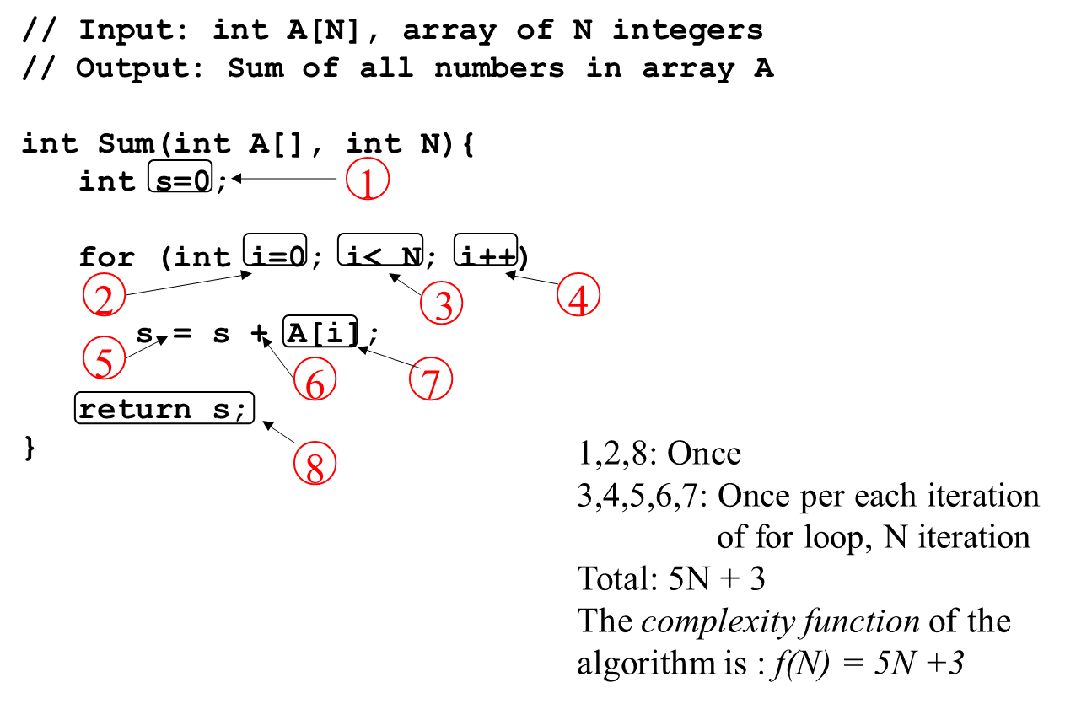
SIMPLE EXAMPLE (2)

Slide 9

SIMPLE EXAMPLE (3)
GROWTH OF 5N+3
Estimated running time for different values of N:
N = 10
N = 100
N = 1,000
N = 1,000,000
=> 53 steps
=> 503 steps
=> 5003 steps
=> 5,000,003 steps
As N grows, the number of steps grow in linear proportion to N for
this function “Sum”

Slide 10
WHAT DOMINATES IN PREVIOUS EXAMPLE?
What about the +3 and 5 in 5N+3?
As N gets large, the +3 becomes insignificant
5 is inaccurate, as different operations require varying amounts of time and
also does not have any significant importance
What is fundamental is that the time is linear in N.
Asymptotic Complexity
: As N gets large, concentrate on the
highest order term:
 Drop lower order terms such as +3
 Drop the constant coefficient of the highest order term i.e. N

Slide 11
ASYMPTOTIC COMPLEXITY
The 5N+3 time bound is said to "grow asymptotically" like N
This gives us an approximation of the complexity of the algorithm
Ignores lots of (machine dependent) details, concentrate on the bigger picture

Slide 12
Asymptotic Notations Properties
Categorize algorithms based on asymptotic growth rate
  e.g. linear, quadratic, exponential
Ignore small constant and small inputs
Estimate upper bound and lower bound on growth rate of time complexity function
Describe running time of algorithm as n grows to ∞.
Limitations
not always useful for analysis on fixed-size inputs.
All results are for sufficiently large inputs.

Slide 13
Asymptotic Notations
Asymptotic Notations Θ, O, Ω, o, ω
We use Θ to mean “order exactly”, (Tight Bound)
O to mean “order at most”, (Tight Upper Bound)
Ω to mean “order at least”, (Tight Lower Bound)
o to mean “upper bound”,
ω to mean “lower bound”,
Define a set of functions: which is in practice used to compare two function sizes.

Slide 14
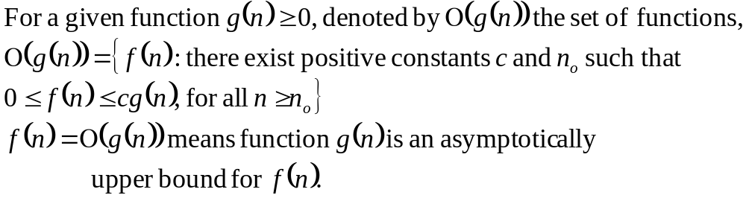
Big-Oh Notation (O)
If f, g: N → R⁺, then we can define Big-Oh as
We may write f(n) = O(g(n)) OR f(n) ∈ O(g(n))
Intuitively:
Set of all functions whose rate of growth is the same as or lower than that of g(n). f(n) is bounded above by g(n) for all sufficiently large n

Slide 15

Big-Oh Notation (O)
f(n) ∈ O(g(n))
∃ c > 0, ∃ n₀ > 0 and ∀n ≥ n₀, 0 ≤ f(n) ≤ c.g(n)
g(n) is an asymptotic upper bound for f(n).

Slide 16
Big-Oh Notation (O)
The idea behind the big-O notation is to establish an upper boundary for the growth of a function f(n) for large n.
This boundary is specified by a function g(n) that is usually much simpler than f(n).
We accept the constant C in the requirement
f(n) ≤ C⋅g(n) whenever n > n₀,
We are only interested in large n, so it is OK if
f(n) > C⋅g(n) for n ≤ n₀.
The relationship between f and g can be expressed by stating either that g(n) is an upper bound on the value of f(n) or that in the long run , f grows at most as fast as g.

Slide 17
Example
As a simple illustrative example, we show that the function 2n² + 5n + 6 is O(n²).
For all n ≥ 1, it is the case that
2n² + 5n + 6 ≤ 2n² + 5n² + 6n² = 13n²
Hence, we can take с = 13 and n_{o} =1, and the definition is satisfied.

Slide 18
Example
Prove that 2n² = O(n³)
Proof:
Assume that f(n) = 2n², and g(n) = n³
f(n) = O(g(n)) ?
Now we have to find the existence of c and n₀
f(n) ≤ c.g(n) ➔ 2n² ≤ c.n³ ➔ 2 ≤ c.n
if we take, c = 1 and n₀= 2 OR
c = 2 and n₀= 1 then
2n² ≤ c.n³
Hence f(n) = O(g(n)), c = 1 and n₀= 2

Slide 19
Example
Prove that n² = O(n²)
Proof:
Assume that f(n) = n², and g(n) = n²
f(n) = O(g(n)) ?
Now we have to find the existence of c and n₀
f(n) ≤ c.g(n) ➔ n² ≤ c.n² ➔ 1 ≤ c
if we take, c = 1, n₀= 1
Then
n² ≤ c.n² for c = 1 and n ≥ 1
Hence, n² = O(n²), where c = 1 and n₀= 1

Slide 20
Example
Prove that 1000.n² + 1000.n = O(n²)
Proof:
Assume that f(n) = 1000.n² + 1000.n, and g(n) = n²
We have to find existence of c and n₀ such that
0 ≤ f(n) ≤ c.g(n) ꓯ n ≥ n₀
1000.n² + 1000.n ≤ c.n²
for c = 1001, 1000.n² + 1000.n ≤ 1001.n²
➔ 1000.n ≤ n² ➔ n² - 1000.n ≥ 0 ➔ n (n-1000) ≥ 0,
this true for n ≥ 1000
Hence f(n) = O(g(n)) for c = 1001 and n₀ = 1000

Slide 21
Example
Prove that n³ = O(n²)
Proof:
On contrary we assume that there exist some positive constants c and n₀ such that
0 ≤ n³ ≤ c.n² ꓯ n ≥ n₀
n ≤ c
Since c is any fixed number and n is any arbitrary constant, therefore n ≤ c is not possible in general.
Hence our supposition is wrong and n³ ≤ c.n², for n ≥ n₀ is not true for any combination of c and n₀.
Hence, n³ = O(n²) does not hold

Slide 22
Example
Prove that 2n + 10 = O(n)
Proof:
Assume that f(n) = 2n + 10, and g(n) = n
f(n) = O(g(n)) ?
Now we have to find the existence of c and n₀
f(n) ≤ c.g(n) ➔ 2n + 10 ≤ c.n ➔ (c − 2) n ≥ 10 ➔ n ≥ 10/(c − 2)
c > 2 for n >0, we pick, c = 3, then n₀= 10
Then
2n + 10 ≤ c.n for c = 3 and n ≥ 10
Hence, 2n + 10 = O(n), where c = 3 and n₀= 10

Slide 23
Example
Prove that : 3n³ + 20n² + 5 = O(n³)
Proof:
Need c > 0 and n₀ ≥ 1 such that
3n³ + 20n² + 5 ≤ c.n³ for n ≥ n₀
This is true for c = 4, n₀= 21
OR c = 28, n₀= 1
Hence, 3n³ + 20n² + 5 = O(n), where c = 4 and n₀= 21

Slide 24
Example
Prove that : 10n + 500 = O(n)
Proof:
Function n will never be larger than the function 500 + 10 n, no matter how large n gets.
However, there are constants c₀ and n₀ such that
500 + 10n ≤ c.n when n ≥ n₀.
One choice for these constants is c = 20 and n₀ = 50.
Other choices for c0 and n0:
  For example, any value of c > 20 will work for n₀ = 50.
Therefore, 500 + 10n = O(n).

Slide 25
Example
Prove which of the following function is larger by order of growth? (1/3)^{n} or 17?
Let’s check if
  (1/3)^{n} = O( 17)
  (1/3)^{n} ≤ c.17, which is true for c=1,n₀ = 1
Let’s check if
  17 = O((1/3)^{n} )
  17 ≤ c. (1/3)^{n} , which is true for c > 17. 3^{n}
And hence can’t be bounded for large n.
That’s why (1/3)^{n} is less in growth rate then 17.

Slide 26
Example
Prove or disprove 2^{2n} = O (2^{n} )?
To prove above argument, we have to show
  2^{2n} ≤ C . 2^{n}
  2^{n} 2^{n} ≤ C .2^{n}
This inequality holds only when
C ≥ 2^{n ,}
which makes C to be non-constant.
Hence we can’t bound 2^{2n} by O(2^{n})

Slide 27
Example
Prove that : 8n² + 2n - 3 ∈ O(n²)
Proof:
Need c > 0 and n₀ ≥ 1 such that
8n² + 2n - 3 ≤ c.n² for n ≥ n₀
Consider the reasoning:
f(n) = 8n² + 2n - 3 ≤ 8n² + 2n ≤ 8n² + 2n² = 10n²
Hence, 8n² + 2n - 3 ∈ O(n²), where c = 10 and n₀= 1

Slide 28
Example
Can you bound 3^{n} = O (2^{n} ) ?
To prove above argument we have to show
  3^{n} ≤ C. 2^{n}
  3^{n} ≤ C. 2^{n}
  3^{n} ≤ (3/2)^{n} 2^{n}
This inequality holds only when C ≥ (3/2)^{n}, which makes C to be non-constant.
Hence we can’t bound 3^{n} by O(2^{n})

Slide 29
Example
Which of the following function is larger by order of growth? N log N or N^{1.5}?
Note that g(N) = N ^{1.5} = N•N ^{0.5}
Hence, between f(N) and g(N), we only need to compare growth rate of log(N) and N ^{0.5}
Equivalently, we can compare growth rate of log²N with N
Now, we can refer to the previously state result to figure out whether f(N) or g(N) grows faster!

Slide 30
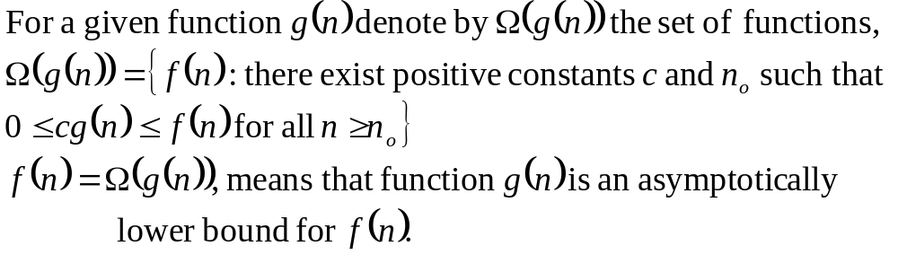
Big-Omega Notation (Ω)
If f, g: N → R⁺, then we can define Big-Omega as
We may write f(n) = Ω(g(n)) OR f(n) ∈ Ω(g(n))
Intuitively:
Set of all functions whose rate of growth is the same as or higher than that of g(n).

Slide 31

Big-Omega Notation (Ω)
f(n) ∈ Ω(g(n))
∃ c > 0, ∃ n₀ > 0 , ∀n ≥ n₀, f(n) ≥ c.g(n)
g(n) is an asymptotically lower bound for f(n).
Note the duality rule: t(n)∈Ω(f(n)) ≡ f(n)∈O(t(n))

Slide 32
Example
Prove that 3n + 2 ∈ Ω(n)
Proof:
Assume that f(n) = 3n + 2 , and g(n) = n
f(n) ∈ Ω(g(n)) ?
We have to find the existence of c and n₀ such that
c.g(n) ≤ f(n) for all n ≥ n₀
c.n ≤ 3n + 2
At R.H.S a positive term is being added to 3n, which will make L.H.S ≤ R.H.S for all values of n, when c = 3.
Hence f(n) ∈ Ω(g(n)), for c = 3 and n₀= 1

Slide 33
Example
Prove that 5.n² ∈ Ω(n)
Proof:
Assume that f(n) = 5.n² , and g(n) = n
f(n) ∈ Ω(g(n)) ?
We have to find the existence of c and n₀ such that
c.g(n) ≤ f(n) for all n ≥ n₀
c.n ≤ 5.n²  c ≤ 5.n
if we take, c = 5 and n₀= 1 then
c.n ≤ 5.n² for all n ≥ n₀
Hence f(n) ∈ Ω(g(n)), for c = 5 and n₀= 1

Slide 34
Example
Prove that 5n² + 2n - 3 ∈ Ω(n²)
Proof:
Assume that f(n) = 5n² + 2n - 3, and g(n) = n²
f(n) ∈ Ω(g(n)) ?
We have to find the existence of c and n₀ such that
c.g(n) ≤ f(n) ꓯ n ≥ n₀
c.n² ≤ 5.n² + 2n - 3
We can take c = 5, given that 2n-3 is always positive.
2n-3 is always positive for n ≥ 2. Therefore n₀ = 2.
And hence f(n) ∈ Ω(g(n)), for c = 5 and n₀= 2

Slide 35
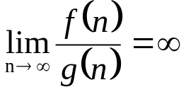
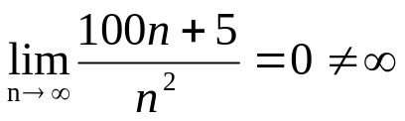
Example
Prove that 100.n + 5 ∉ Ω(n²)
Proof:
Let f(n) = 100.n + 5, and g(n) = n²
Assume that f(n) ∈ Ω(g(n)) ?
Now if f(n) ∈ Ω(g(n)) then there exist c and n₀ such that
c.g(n) ≤ f(n) for all n ≥ n₀
c.n² ≤ 100.n + 5
For the above inequality to hold meaning f(n) grows faster than g(n).
But which means g(n) is growing faster than f(n)
and hence f(n) ∉ Ω(g(n))

Slide 36
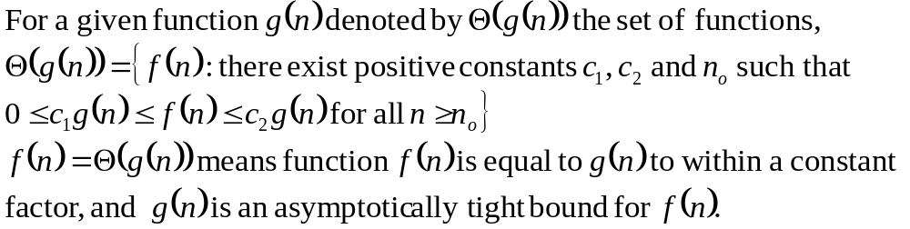
Theta Notation (Θ)
If f, g: N → R⁺, then we can define Big-Theta as
We may write f(n) = Θ(g(n)) OR f(n) ∈ Θ(g(n))
Intuitively: Set of all functions that have same rate of growth as g(n).
When a problem is Θ(n), this represents both an upper and lower bound i.e. it is O(n) and Ω(n) (no algorithmic gap)

Slide 37

Theta Notation (Θ)
f(n) ∈ Θ(g(n))
∃ c₁> 0, c₂> 0, ∃ n₀ > 0, ∀ n ≥ n₀, c_{2.}g(n) ≤ f(n) ≤ c_{1.}g(n)
We say that g(n) is an asymptotically tight bound for f(n).

Slide 38
Example
Prove that ½.n² – ½.n = Θ(n²)
Proof
Assume that f(n) = ½.n² – ½.n, and g(n) = n²
f(n) ∈ Θ(g(n))?
We have to find the existence of c₁, c₂ and n₀ such that
c₁.g(n) ≤ f(n) ≤ c₂.g(n) for all n ≥ n₀
Since, ½ n² - ½ n ≤ ½ n² ∀n ≥ 0 if c₂= ½ and
½ n² - ½ n ≥ ½ n² - ½ n . ½ n ( ∀n ≥ 2 ) = ¼ n^{2,} c₁= ¼
Hence ½ n² - ½ n ≤ ½ n² ≤ ½ n² - ½ n
c₁.g(n) ≤ f(n) ≤ c₂.g(n) ∀n ≥ 2, c₁= ¼, c₂ = ½
Hence f(n) ∈ Θ(g(n)) ⇒ ½.n² – ½.n = Θ(n²)

Slide 39
Example
Prove that 2.n² + 3.n + 6 = Θ(n³)
Proof: Let f(n) = 2.n² + 3.n + 6, and g(n) = n³
we have to show that f(n) = Θ(g(n))
On contrary assume that f(n) ∈ Θ(g(n)) i.e. there exist some positive constants c₁, c₂ and n₀ such that:
c₁.g(n) ≤ f(n) ≤ c₂.g(n)
Solve for c₂:
f(n) ≤ c₂.g(n)  2n² + 3n + 6 ≤ 2n² + 3n² + 6n² ≤ c₂n³  c = 11 and n₀= 1
Solve for c₁:
c₁.g(n) ≤ f(n)  c₁n³ ≤ 2n² + 3n + 6  c₁n³ ≤ 2n² ≤ 2n² + 3n + 6
c₁.n ≤ 2, for large n this is not possible
Hence f(n)  Θ(g(n)) ⇒ 2.n² + 3.n + 6  Θ(n³)

Slide 40
Example
Prove that 3.n + 2 = Θ(n)
Proof: Let f(n) = 3.n + 2, and g(n) = n
Assume that f(n) ∈ Θ(g(n)) i.e. there exist some positive constants c₁, c₂ and n₀ such that:
c₁.g(n) ≤ f(n) ≤ c₂.g(n)
c₁.n ≤ 3.n + 2 ≤ c₂. n 
Take c₁ = 3, as 3n ≤ 3n + 2 with n₀ = 1
3n + 2 ≤ 3n + 2n ≤ c₂. n ➔ 5n ≤ c₂. n ➔ 5 ≤ c₂
c₁ = 3, c₂ = 5, n₀ = 1
Hence f(n)  Θ(g(n)) ⇒ 3.n + 2 = Θ(n)

Slide 41
Example from the book
Prove that ½.n² – 3.n = Θ(n²)
Proof
Let f(n) = ½.n² – 3.n, and g(n) = n² f(n) ∈ Θ(g(n))?
We have to find the existence of c₁, c₂ and n₀ such that
c₁.g(n) ≤ f(n) ≤ c₂.g(n) ꓯ n ≥ n₀
c₁. n² ≤ ½.n² – 3.n ≤ c₂. n²
Since, ½ n² - 3 n ≤ ½ n² ∀n ≥ 1 if c₂= ½ and
  ½ n² - 3 n ≥ 1/4 n² ( ∀n ≥ 6 ), c₁= ¼
c₁.g(n) ≤ f(n) ≤ c₂.g(n) ∀n ≥ 6, c₁= ¼, c₂ = ½
Hence f(n) ∈ Θ(g(n)) ⇒ ½.n² – 3.n = Θ(n²)

Slide 42
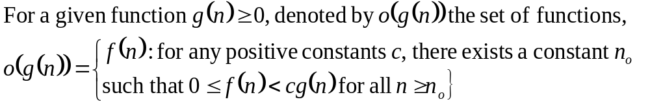
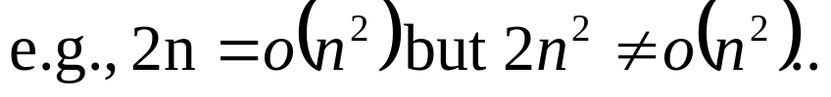
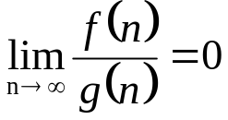
Little-Oh Notation
o-notation is used to denote a upper bound that is not asymptotically tight.
f(n) becomes insignificant relative to g(n) as n approaches infinity. g(n) is an upper bound for f(n), not asymptotically tight

Slide 43
Example
Prove that 2n² ∈ o(n³)
Proof:
Assume that f(n) = 2n² , and g(n) = n³
f(n) ∈ o(g(n)) ?
Now we have to find the existence n₀ for any c
f(n) < c.g(n) this is true
 2n² < c.n³  2 < c.n
This is true for any c, because for any arbitrary c we can choose n₀ such that the above inequality holds.
Hence f(n) ∈ o(g(n))

Slide 44
Example
Prove that n² ∉ o(n²)
Proof:
Assume that f(n) = n² , and g(n) = n²
Now we have to show that f(n) ∉ o(g(n))
Since
f(n) < c.g(n)  n² < c.n²  1 ≤ c,
In our definition of small o, it was required to prove for any c but here there is a constraint over c .
Hence, n² ∉ o(n²), where c = 1 and n₀= 1

Slide 45
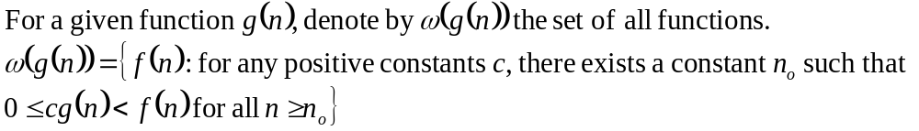
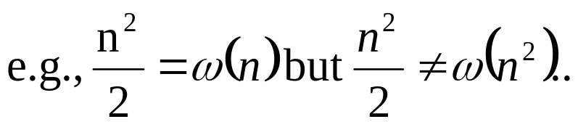
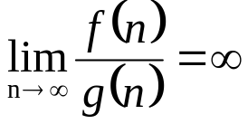
Little-Omega Notation
Little-ω notation is used to denote a lower bound that is not asymptotically tight.
f(n) becomes arbitrarily large relative to g(n) as n
approaches infinity

Slide 46
Example
Prove that 5.n² ∈ ω(n)
Proof:
Assume that f(n) = 5.n² , and g(n) = n
f(n) ∈ Ω(g(n)) ?
We have to prove that for any c there exists n₀ such that
c.g(n) < f(n) ꓯ n ≥ n₀
c.n < 5.n²  c < 5.n
This is true for any c, because for any arbitrary c e.g. c = 1000000, we can choose n₀ = 1000000/5 = 200000 and the above inequality does hold.
And hence f(n) ∈ ω(g(n))

Slide 47
Example
Prove that 5.n + 10 ∉ ω(n)
Proof:
Assume that f(n) = 5.n + 10, and g(n) = n
f(n) ∉ Ω(g(n)) ?
We have to find the existence n₀ for any c, such that
c.g(n) < f(n) ꓯ n ≥ n₀
c.n < 5.n + 10, if we take c = 16 then
16.n < 5.n + 10 ⇔ 11.n < 10 is not true for any positive integer.
Hence f(n) ∉ ω(g(n))

Slide 48
Example
Prove that 100.n ∉ ω(n²)
Proof:
Let f(n) = 100.n, and g(n) = n²
Assume that f(n) ∈ ω(g(n))
Now if f(n) ∈ ω(g(n)) then there n₀ for any c such that
c.g(n) < f(n) ꓯ n ≥ n₀
 c.n² < 100.n  c.n < 100
If we take c = 100, n < 1, not possible
Hence f(n)  ω(g(n)) i.e. 100.n ∉ ω(n²)

Slide 49
Asymptotic Functions Summary
If f(n) = Θ(g(n)) we say that f(n) and g(n) grow at the same rate, asymptotically
If f(n) = O(g(n)) and f(n) ≠ Ω(g(n)), then we say that f(n) is asymptotically slower growing than g(n).
If f(n) = Ω(g(n)) and f(n) ≠ O(g(n)), then we say that f(n) is asymptotically faster growing than g(n).

Slide 50
Usefulness of Notations
It is not always possible to determine behaviour of an algorithm using Θ-notation.
For example, given a problem with n inputs, we may have an algorithm to solve it in a.n² time when n is even and c.n time when n is odd. OR
We may prove that an algorithm never uses more than e.n² time and never less than f.n time.
In either case we can neither claim Θ(n) nor Θ(n²) to be the order of the time usage of the algorithm.
Big O and Ω notation will allow us to give at least partial information

Slide 51
Usefulness of Notations
To express the efficiency of our algorithms which of the three notations should we use?
As computer scientist we generally like to express our algorithms as big O since we would like to know the upper bounds of our algorithms.
Why?
If we know the worse case then we can aim to improve it and/or avoid it.

Slide 52
Usefulness of Notations
Even though it is correct to say “7n - 3 is O(n³)”, a better statement is “7n - 3 is O(n)”, that is, one should make the approximation as tight as possible
Simple Rule:
Drop lower order terms and constant factors
  7n-3 is O(n)
  8n²log n + 5n² + n is O(n²log n)
Strictly speaking this use of the equals sign is incorrect
  the relationship is a set inclusion, not an equality
  f(n) ∈ O(g(n)) is better

Slide 53
Big Oh Does Not Tell the Whole Story
Question?
If two algorithms A and B have the same asymptotic complexity, say O(n²), will the execution time of the two algorithms always be same?
How to select between the two algorithms having the same asymptotic performance?
Answer:
They may not be the same. There is this small matter of the constant of proportionality.
Suppose that A does ten operations for each data item, but algorithm B only does three.
It is reasonable to expect B to be faster than A even though both have the same asymptotic performance. The reason is that asymptotic analysis ignores constants of proportionality.
Notes:
Suppose you have a choice of two approaches to writing a program. Both approaches have the same asymptotic performance (for example, both are O(n lg(n)).
Why select one over the other, they're both the same, right?
They may not be the same. There is this small matter of the constant of proportionality. Suppose algorithms A and B have the same asymptotic performance,
TA(n) = TB(n) = O(g(n)).
Now suppose that A does ten operations for each data item, but algorithm B only does three. It is reasonable to expect B to be faster than A even though both have the same asymptotic performance. The reason is that asymptotic analysis ignores constants of proportionality.

Slide 54
Big Oh Does Not Tell the Whole Story
Algorithm_A {
set up the algorithm; /*taking 50 time units*/
read in n elements into array A; /* 3 units per element */
for (i = 0; i < n; i++) {
do operation1 on A[i]; /* takes 10 units */
do operation2 on A[i]; /* takes 5 units */
do operation3 on A[i]; /* takes 15 units */
}
}
TA(n) = 50 + 3n + (10 + 5 + 15)*n
= 50 + 33*n
Algorithm_B {
set up the algorithm; /*taking 200 time units*/
read in n elements into array A; /* 3 units per element */
for (i = 0; i < n; i++) {
do operation1 on A[i]; /* takes 10 units */
do operation2 on A[i]; /* takes 5 units */
}
}
TB(n) = 200 + 3n + (10 + 5)*n
= 200 + 18*n

Slide 55
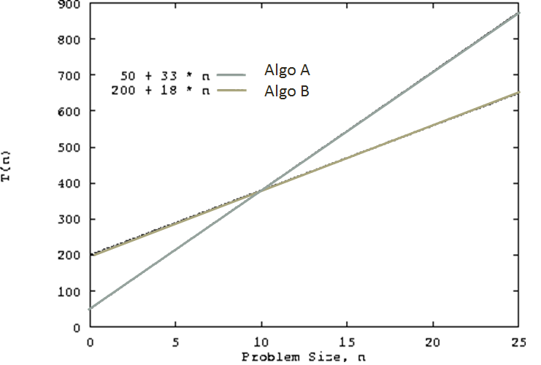
Big Oh Does Not Tell the Whole Story
Both algorithms have time complexity O(n).
Algorithm A sets up faster than B, but does more operations on the data
Algorithm A is the better choice for small values of n.
For values of n > 10, algorithm B is the better choice

Slide 56
A Misconception
A common misconception is that worst case running time is somehow defined by big-Oh, and that best case is defined by big-Omega.
There is no formal relationship like this.
However, worst case and big-Oh are commonly used together, because they are both techniques for finding an upper bound on running time.

Slide 57
Relations over Asymptotic Notations
Maximum rule: O(f(n)+g(n)) = O( max(f(n),g(n)) )
Additive and Multiplicative Property:
If e(n) = O(g(n)) & f(n) = O(h(n)) then e(n) + f(n) = O(g(n) + h(n))
If e(n) = O(g(n)) & f(n) = O(h(n)) then e(n) • f(n) = O(g(n) • h(n))
Dichotomy Property: If f(n) = O(g(n)) & g(n) = O(f(n)) then f(n) = Θ(g(n))
If f(n) = Ω(g(n)) and g(n) = Ω(f(n)) then f(n) = Θ(g(n))
Reflexive Property: If f(n) = O(f(n)) and f(n) = Ω(f(n)) and f(n) = Θ(f(n))
f(n) ≠ o(f(n)) and f(n) ≠ ω(f(n))
Symmetry over Θ: f(n) = Θ(g(n)) ⇔ g(n) = Θ(f(n))
Transitivity Property:
f(n) = Θ(g(n)) & g(n) = Θ(h(n)) ⇒ f(n) = Θ(h(n))
f(n) = O(g(n)) & g(n) = O(h(n)) ⇒ f(n) = O(h(n))
f(n) = Ω(g(n)) & g(n) = Ω(h(n)) ⇒ f(n) = Ω(h(n))
f(n) = o (g(n)) & g(n) = o (h(n)) ⇒ f(n) = o (h(n))
f(n) = ω(g(n)) & g(n) = ω(h(n)) ⇒ f(n) = ω(h(n))

